Slide 1
Employee Data Analysis using Excel
STUDENT NAME:
REGISTER NO:
DEPARTMENT:
COLLEGE

Slide 2
PROJECT TITLE
Employee Performance Analysis using Excel

Slide 3


AGENDA
Problem Statement
Project Overview
End Users
Our Solution and Proposition
Dataset Description
Modelling Approach
Results and Discussion
Conclusion
3/21/2024 Annual Review

Slide 4

PROBLEM STATEMENT

Slide 5

PROJECT OVERVIEW
.

Slide 6

WHO ARE THE END USERS?

Slide 7

OUR SOLUTION AND ITS VALUE PROPOSITION

Slide 8
Dataset Description

Slide 9

THE "WOW" IN OUR SOLUTION
3/21/2024 Annual Review
9

Slide 10
MODELLING
10

Slide 11
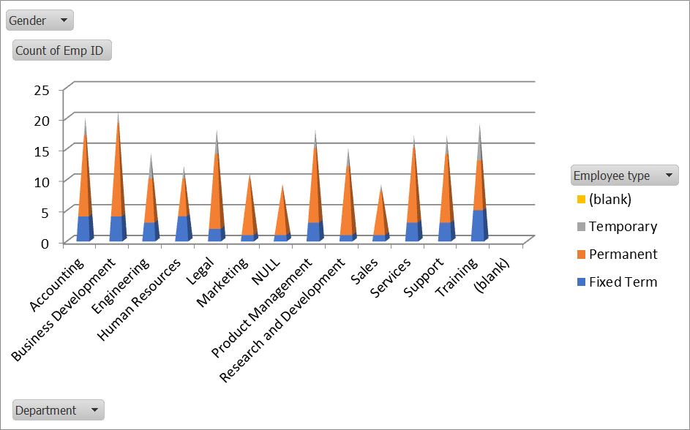
RESULTS
EMPLOYEE PERFORMANCE ANALYSIS
11

Slide 12
conclusion

